Slide 1
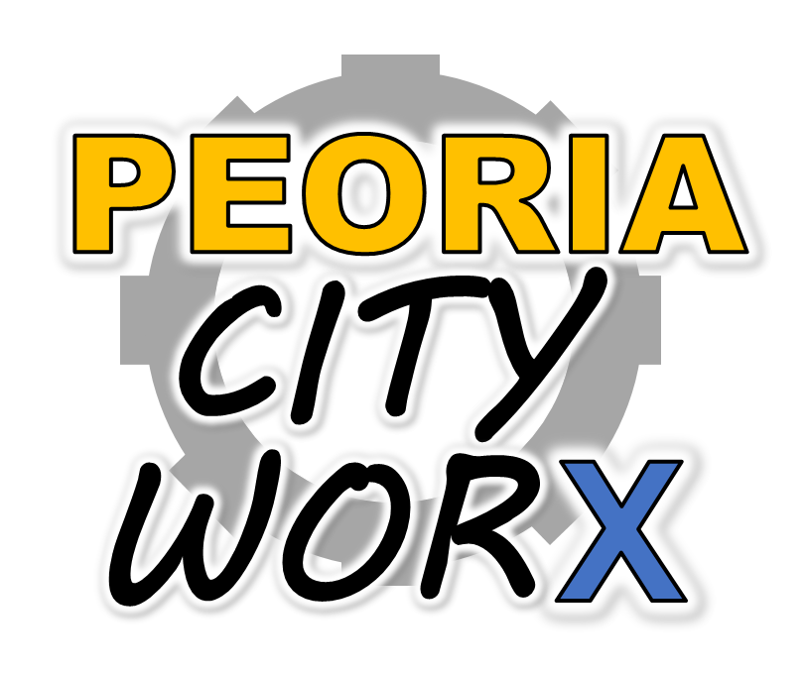
An Application from Working as Designed
Notes:
We are Working as Designed and it is our pleasure to present to you Peoria City Worx.

Slide 2
Our Users
The user journey of Peoria Worx is the story of four people who live, work or play in Peoria and are impacted by the status of our transportation infrastructure. They are:
Nick the neighborhood leader
Bob the business owner
Valerie the visitor
Chuck the contractor
Notes:
The user journey of Peoria Worx is the story of four people who live, work or play in Peoria and are impacted by the status of our transportation infrastructure. They are: - Nick the neighborhood leader
- Bob the business owner - Valerie the visitor - Chuck the contractor

Slide 3
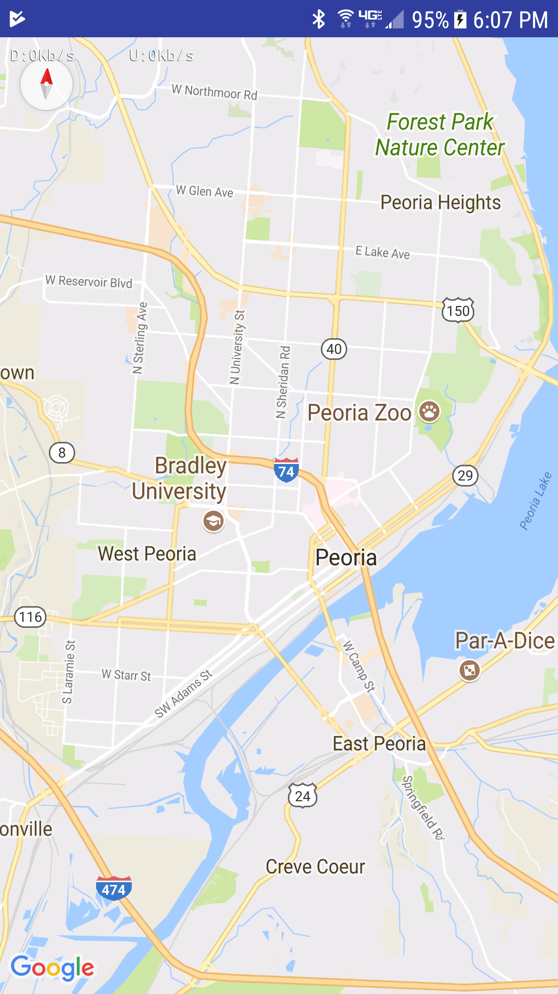
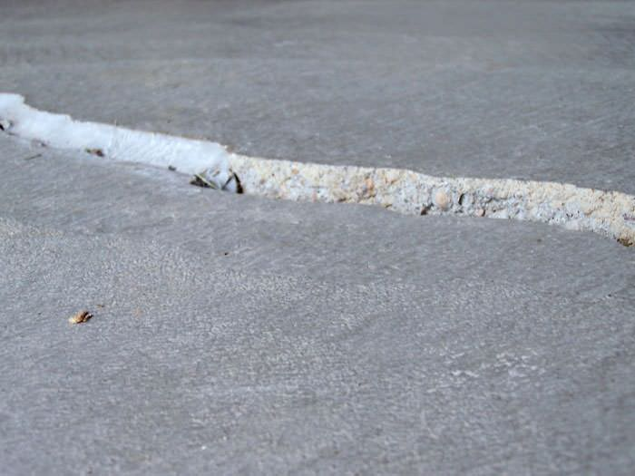
Experience #1 - Documenting Repair Needs
Notes:
Meet Nick, he is a family man and neighborhood leader. As Nick and his wife walk their dog one evening, he notices a severely damaged stretch of sidewalk that may be a safety hazard. Nick pulls out his Peoria City Worx app and captures a picture of the problem, quickly attaching the photo and geolocation to an automated ticket placed with the Public Works department. Nick will periodically check back on the status of the tickets he has placed to ensure that they have been resolved. A quick contact link within the app connects him to a call center if he has additional questions.

Slide 4
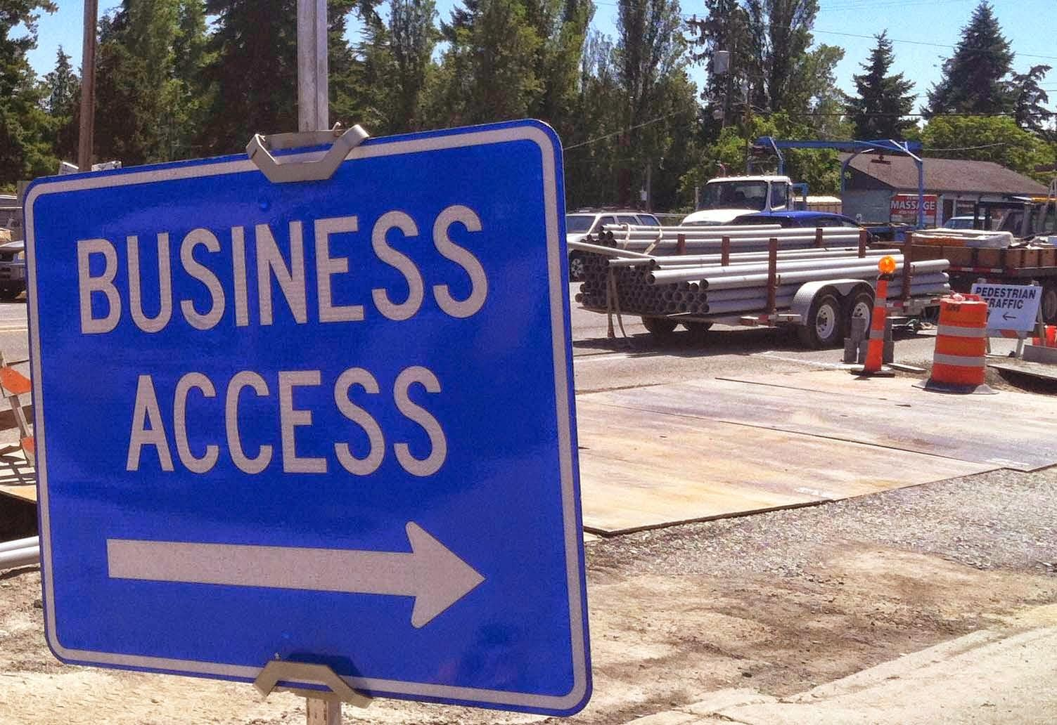
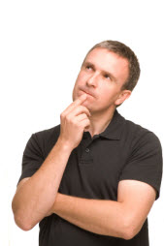
Experience #2 - Preparing for Future Construction
Notes:
Meet Bob. Bob owns a centrally located business in Peoria. He sees driveup traffic of a few hundred per day. His business has only one driveway accessible from Knoxville. Bob would like to understand when construction projects near his business will impact the flow of traffic so that he can adapt. He opens his Peoria CIty Worx app and filters by current and permitted projects. The app displays all of the ongoing road construction projects, regardless of governmental jurisdiction. Bob has heard a rumor that the section of Knoxville in front of his business will be closed soon, but he doesn’t see anything at this time. Since he configured his notifications for a one mile radius from his business, Bob gets a text message for a resurfacing project in front of his business that has just been permitted and will begin shortly. He marks it as a favorite to follow and will need to adapt his signage to ensure he doesn’t see a slow down in business.

Slide 5
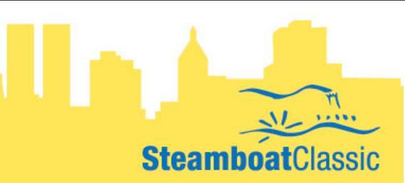
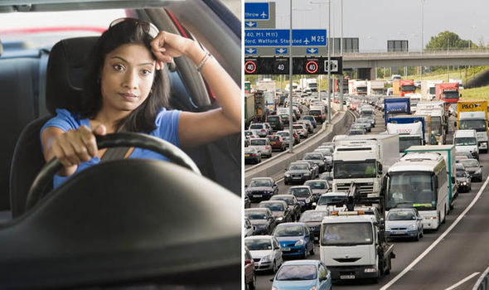
Experience #3 - Project Notification & Rerouting
Notes:
Meet Valerie. Valerie is a frequent visitor to Peoria, in part because she is one of Bob’s loyal customers. Since Valerie has configured her common route, Peoria City Worx is querying a Google Maps API to determine if there is a better route. As Valerie hops in her car this morning, the app reports to her that there has been a recommended change to that route. The app shares the latest status report for a project that triggered the rerouting, in this case the temporary shutdown of some city streets due to the Steamboat Classic. Valerie adjusts her course and makes note that she should check out the festival on the way back.

Slide 6
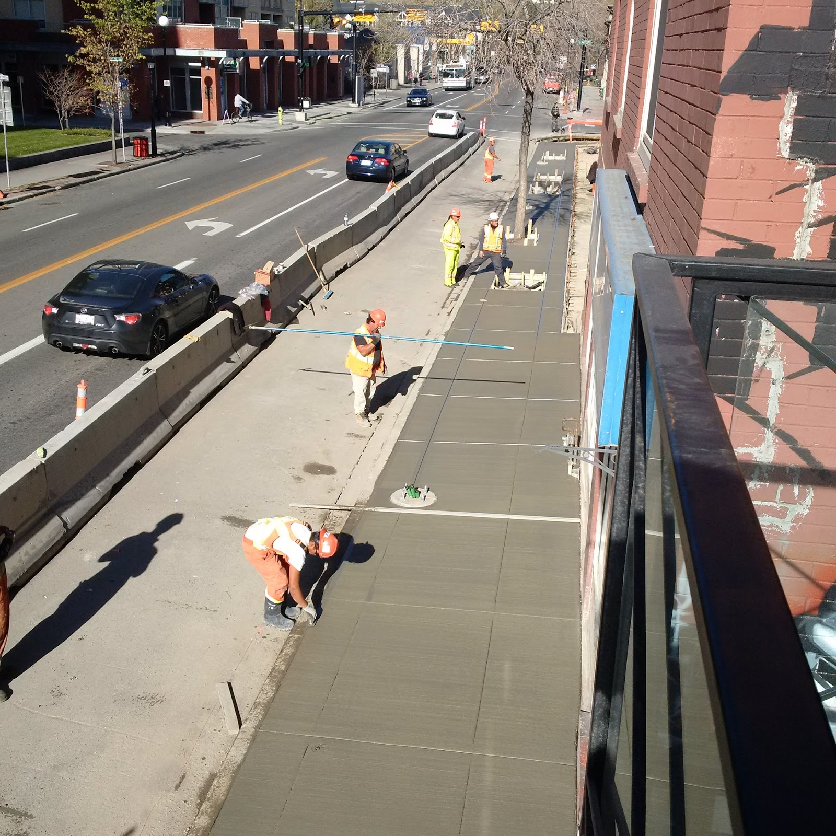
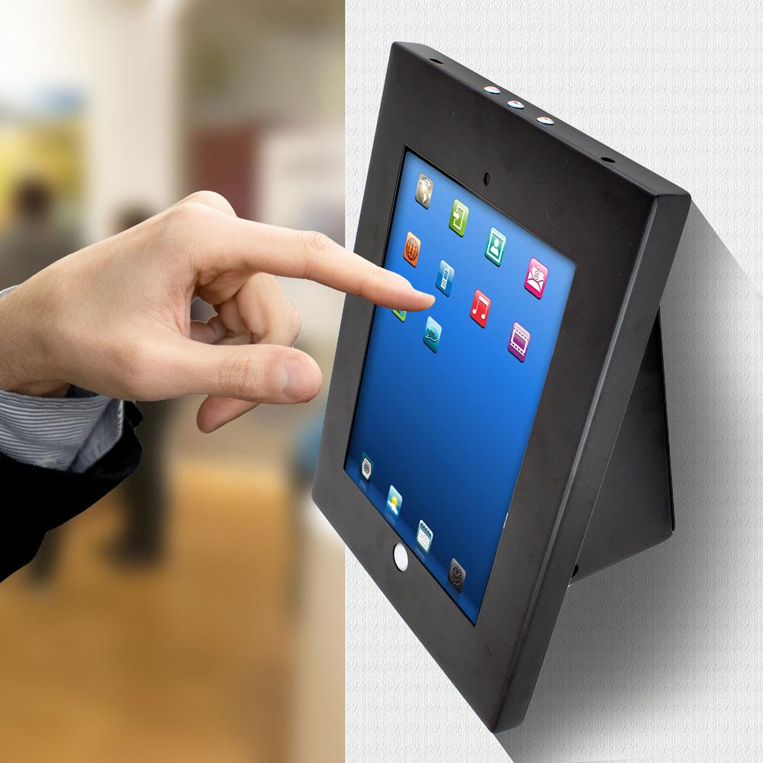
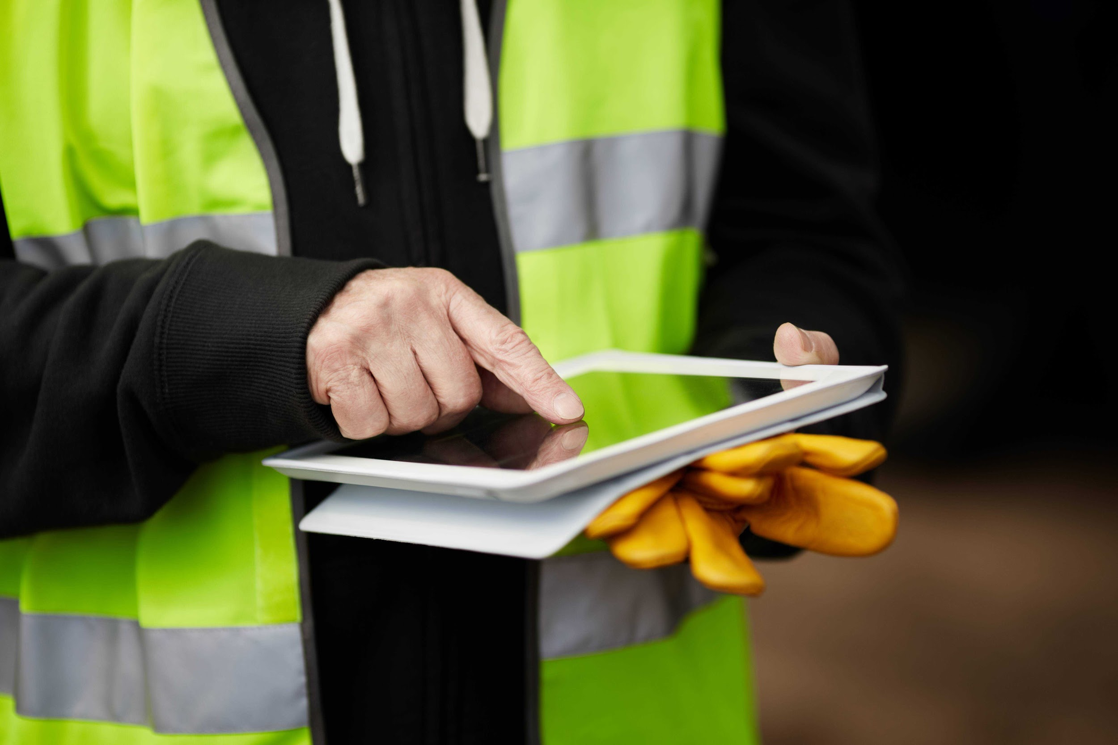
Experience #4 - Keeping Everyone in the Loop
Notes:
Meet Chuck. Chuck is the general contractor on the street project running in front of Bob’s business. Every night before he leaves, Chuck updates the project status and reviews comments that have been placed against his project. This evening, Chuck will mark the project as delayed. Due to an unexpected rain, the project will complete a day late. This gives Bob, Nick and Valerie awareness to the change in plans. In response to a new comment he received from the site kiosk running the Peoria City Worx app, Chuck will update his signage so that one end of his road construction site is more visible.

Slide 7
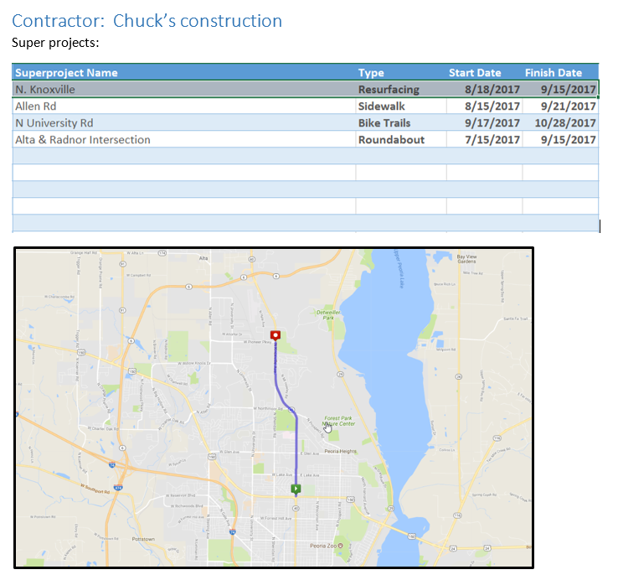
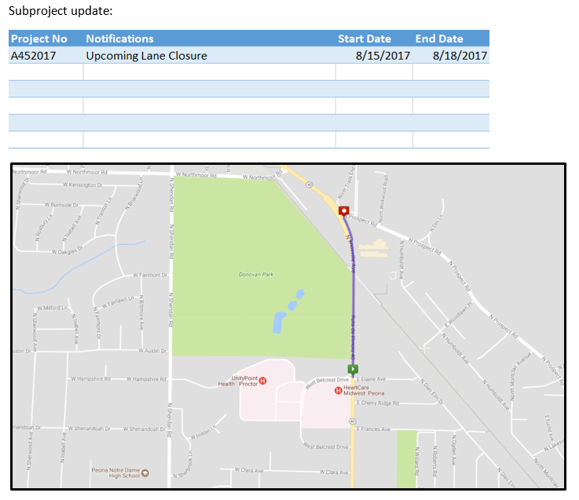
Project Updates

Slide 8
Four User Roles. One City. One App.
Notes:
Four User Roles. One City. One App. This is Peoria City Worx.

